Slide 1
Car Price Analysis Using Power BI
Afnan v.t
Date Of Presentation :05/04/2025

Slide 2
Introduction
- Understanding car price distribution based on various attributes.
- Helps buyers, sellers, and analysts make informed decisions.
- Power BI enables interactive data visualization and insightful analytics.

Slide 3
Objectives
-This project focuses on predicting used car prices in Indian by analyzing key features like make, model and condition.
- Analyzing the factors affecting car prices.
- Identifying trends in car prices based on fuel type, brand, model, and other attributes.

Slide 4
Dataset
- Data Source: Kaggle/UCI
-total records :32200 rows
-total features : 14
- Key Features: Brand, Model, Transmission, Fuel, Price, Mileage, etc.
- Data Type: the dataset contains a mix of numeric and categorical
- Challenges: Missing values, inconsistencies.

Slide 5
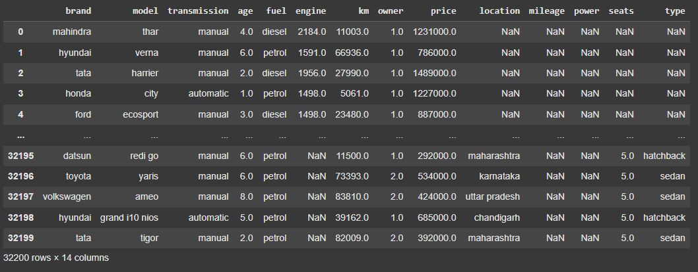

Slide 6
Methodology
- Data Preprocessing (Cleaning, Handling Missing Values, Feature Selection)
- Data Visualization using Power BI
- Representing insights with visual dashboards.
Project Workflow (Step-by-Step)
1.Import Libraries & Load Data
2.Initial Data Exploration
3.Data Cleaning
4.Descriptive Statistics
5.Data Visualization
6.Outlier Detection & Handling
8.Data Scaling
9.Modeling & Hypothesis Testing

Slide 7
Model Selection & Implementation
- Criteria for selecting an analytical or predictive model.
- Justification for using Power BI for visualization.
- Steps involved in building dashboards for analysis.
Random Forest Regressor – To handle nonlinear relationships and improve accuracy.
Random Forest:
Handles feature interactions well, robust to outliers and nonlinearity, and suitable for medium-sized datasets.

Slide 8
Evaluation & Results
- Performance evaluation of analysis techniques.
- Accuracy and relevance of visualizations.
- Any statistical measures used to support findings.
Random Forest:
R2 : 0.72

Slide 9
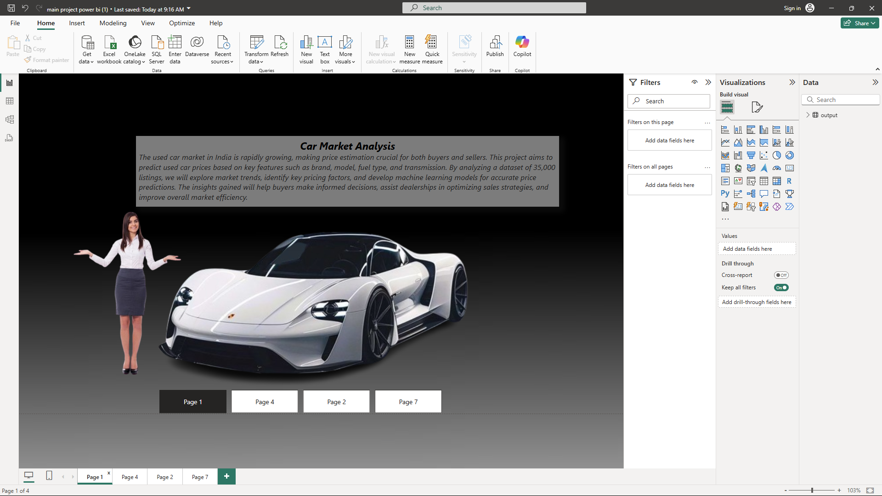

Slide 10
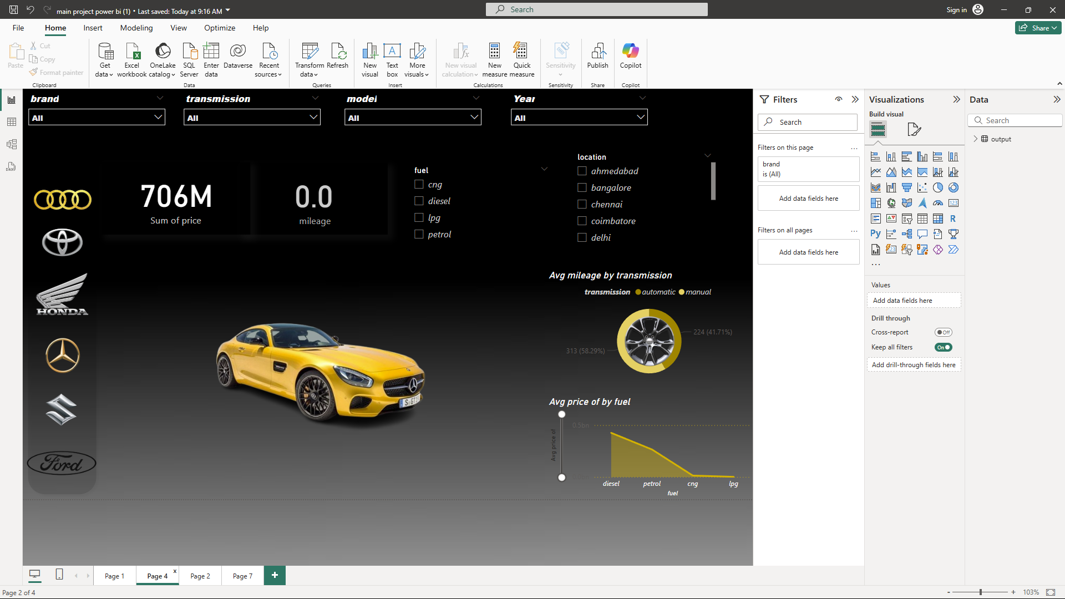

Slide 11
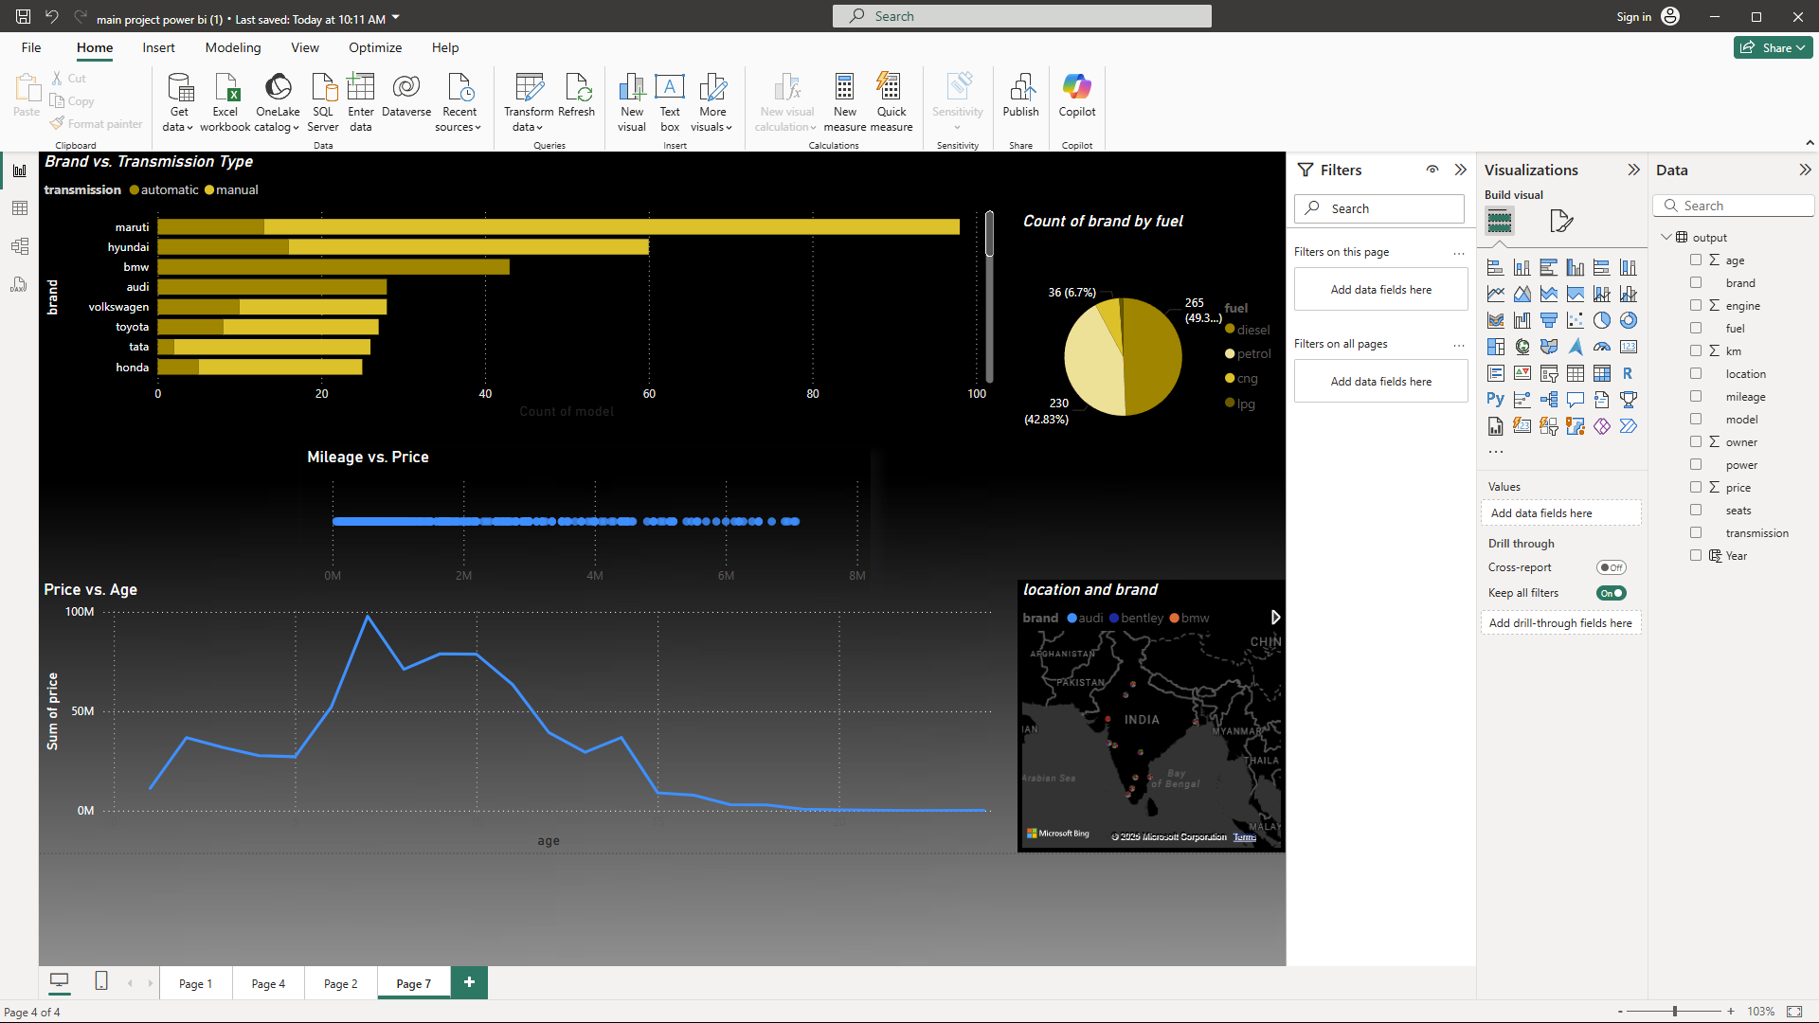

Slide 12
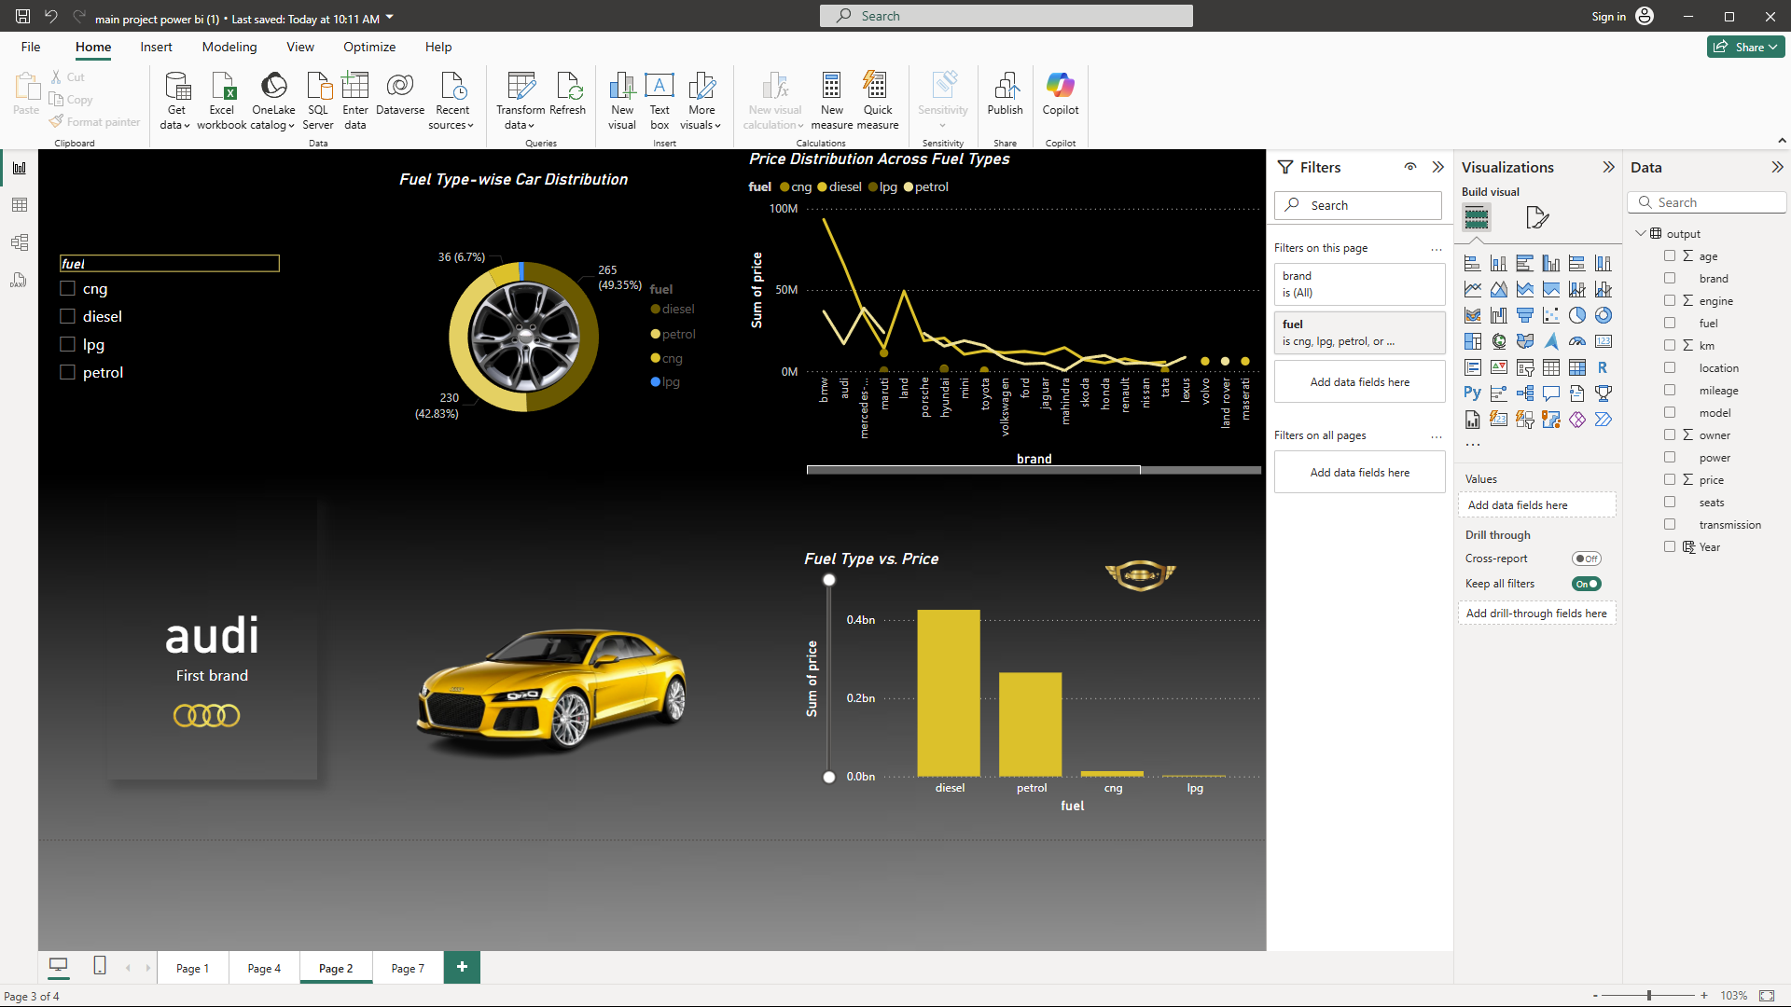

Slide 13
Conclusion & Future Work
- Key takeaways from the project.
- Scope for improvement (Better data, additional features, advanced analytics).
- Future enhancements (Live data updates, integration with predictive models).

